Slide 1
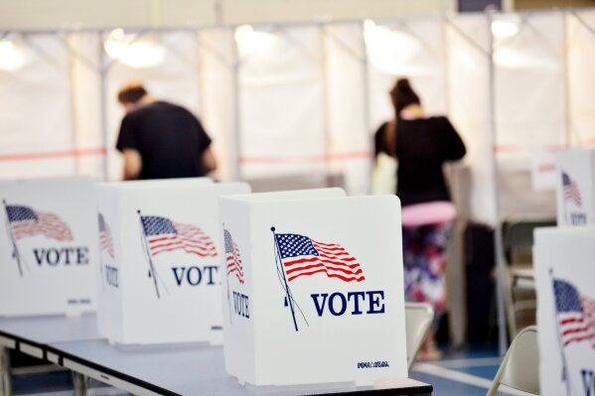
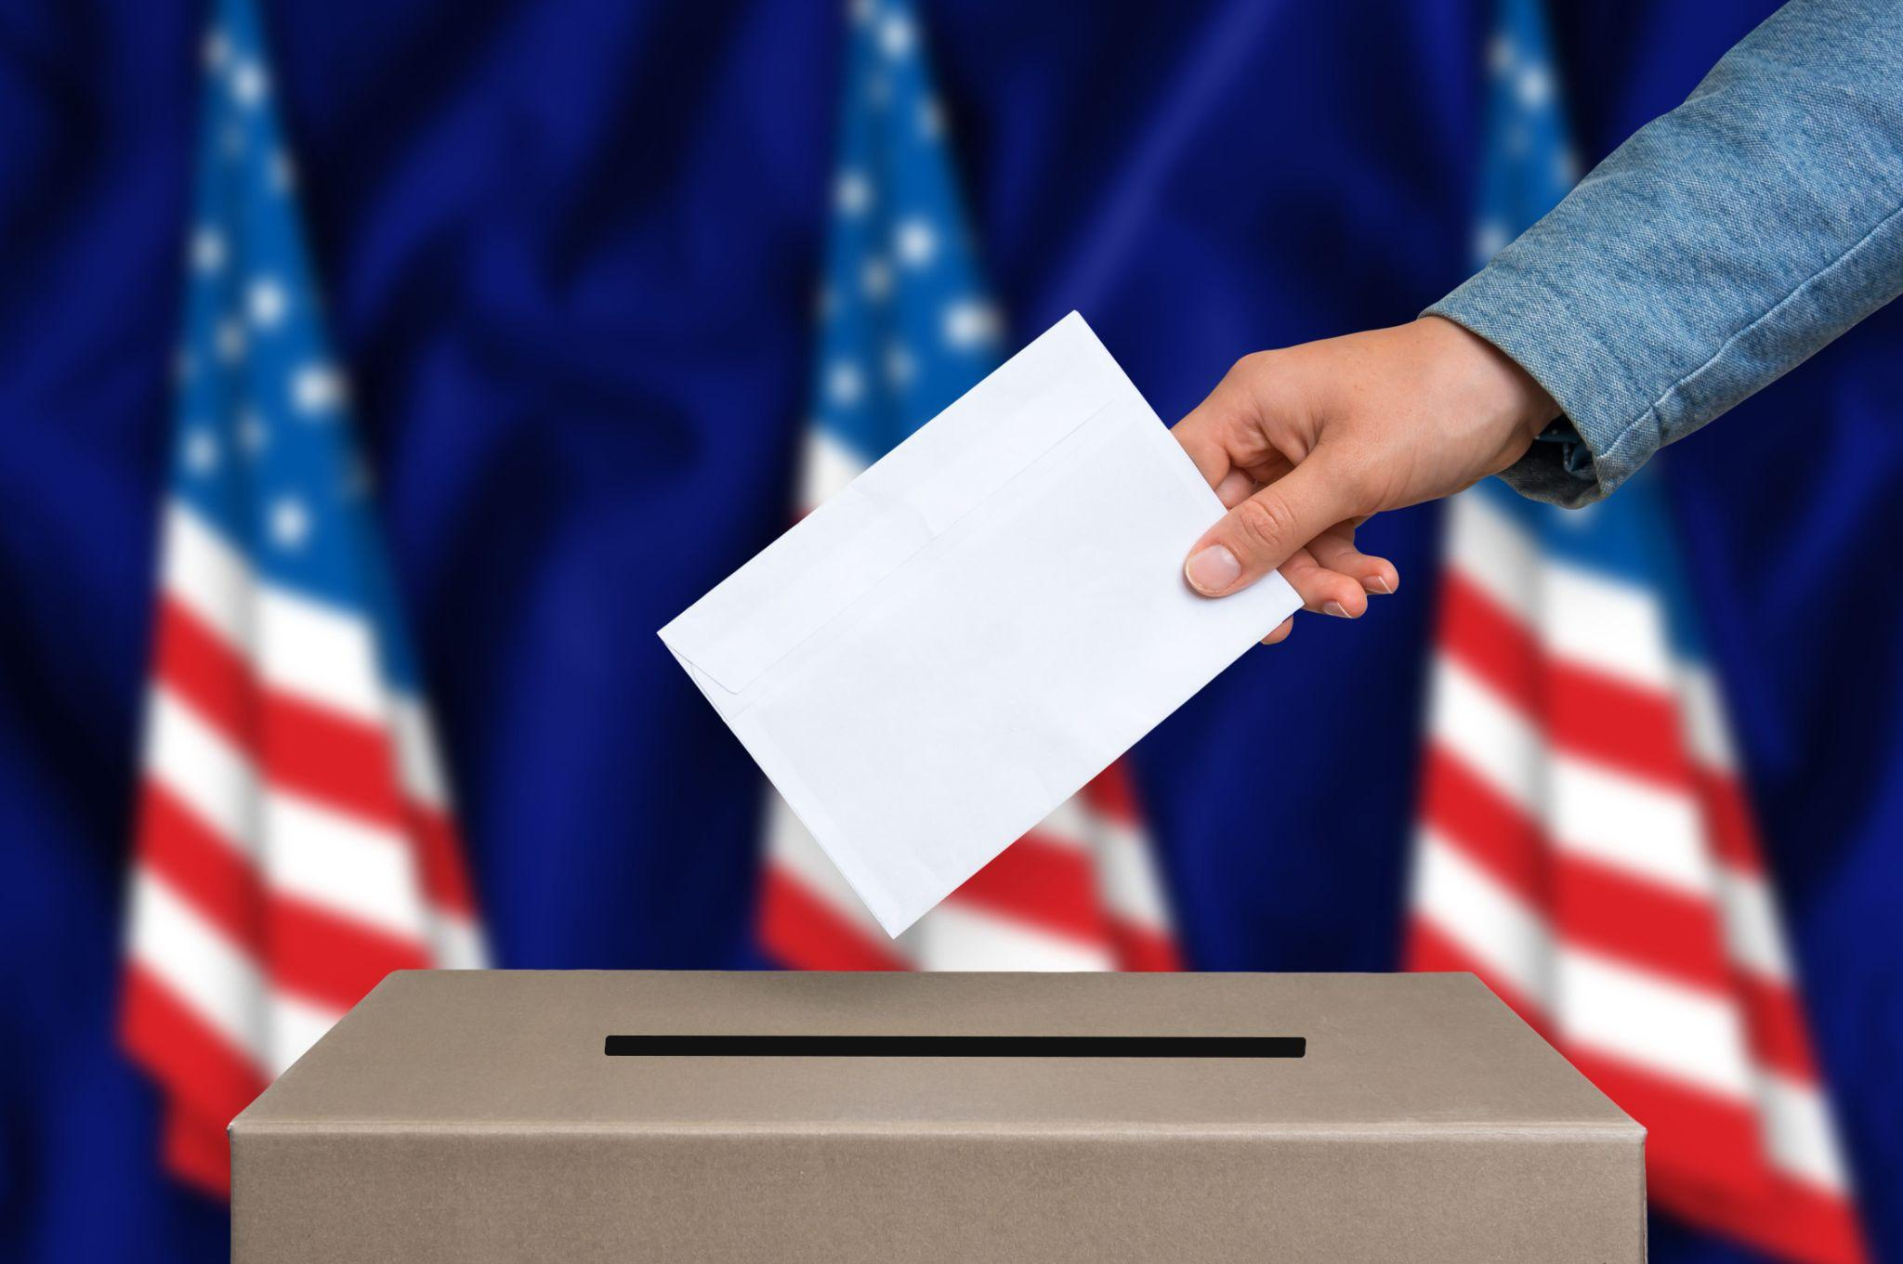
11/28/2024
SHIRAJUS SALEKIN NABIL - 19889
Ballot.sol A COMPLETE WALK THROUGH OF THE PROJECT

Slide 2
SHIRAJUS SALEKIN NABIL - 19889
TABLE OF CONTENTS
TABLE OF CONTENTS
1
2
3
4
5
6
7
8
9
Abstract
Introduction
Prerequisite Section
Implementation Section
Experimenting Use Cases
Enhancement Ideas
Conclusion
References
Thank You

Slide 3
CYMBAL
SHIRAJUS SALEKIN NABIL - 19889
PRODUCT OVERVIEW
Abstract:
This project demonstrates the development of a decentralized voting system on Ethereum’s Sepolia Testnet. Using faucets and mining, testnet ETH was acquired to deploy a Solidity smart contract via MetaMask and Remix IDE. The contract was tested for assigning voting rights, vote delegation, and tallying results across multiple accounts.
Key outcomes include a fully functional voting system where proposal 2 emerged as the winner. The work highlights blockchain’s potential for secure and transparent governance, with recommendations for future scalability and real-world identity integration.
WHAT WE’RE GOING TO DO
ABSTRACT

Slide 4
SHIRAJUS SALEKIN NABIL - 19889
INTRODUCTION
INTRODUCTION
The adoption of blockchain technology has revolutionized transparency and trust in decentralized systems, with voting processes being a promising use case. The motivation behind this work lies in addressing challenges in traditional voting systems, such as lack of transparency, voter fraud, and centralized control, by leveraging the immutability and decentralization of blockchain.
Problem Description
Traditional voting systems are often criticized for their vulnerability to manipulation, lack of transparency, and inefficiencies in managing voter identities and ballots. In a decentralized setting, ensuring secure, trustless, and efficient voting processes presents its own set of challenges, including account management, assigning voting rights, and accurately counting votes.

Slide 5
CYMBAL
SHIRAJUS SALEKIN NABIL - 19889
PRODUCT OVERVIEW
INTRODUCTION
INTRODUCTION
Objectives This project aims to design, deploy, and validate a decentralized voting system on the Ethereum blockchain. The specific focus is on implementing a smart contract to assign voting rights, manage vote delegation, and securely tally results while maintaining transparency.
Research Focus The study focuses on addressing issues such as voter authentication, ensuring fairness in vote delegation, and securely handling proposal outcomes. The research design includes developing a Solidity-based smart contract, testing it on Ethereum’s Sepolia Testnet, and simulating real-world voting scenarios. The hypothesis is that blockchain-based voting systems can provide secure, transparent, and efficient alternatives to traditional methods.
Relevant Theory
Blockchain technology ensures immutability and decentralization, making it ideal for trustless voting. Smart contracts, self-executing agreements coded on the blockchain, automate processes such as assigning voting rights and tallying results. The Ethereum blockchain and its development tools, such as MetaMask and Remix IDE, form the technical backbone of this project.
Review of Past Work
Prior studies have demonstrated blockchain’s potential in enhancing transparency in elections. However, challenges such as scalability, identity verification, and user adoption remain areas of active research. This work builds upon these insights by focusing on a functional prototype of a decentralized voting system.

Slide 6
SHIRAJUS SALEKIN NABIL - 19889
INTRODUCTION
INTRODUCTION
Proposed Solution
The proposed system involves designing and deploying a Solidity-based smart contract to handle voting processes, including rights assignment, vote delegation, and proposal evaluation. Testing is conducted using the Sepolia Testnet to ensure secure and efficient execution.
Organization of the Report This document is organized as follows:
Section 1: Introduction - Provides an overview of the problem, motivation, objectives, and structure of the report.
Section 2: Design and Implementation - Details the smart contract design, account management, and integration with Ethereum tools.
Section 3: Results and Analysis - Discusses the outcomes of the voting simulations and system performance.
Section 4: Challenges and Future Work - Explores limitations and potential enhancements, including scalability and identity integration.
Section 5: Conclusion - Summarizes the work and its implications for decentralized voting systems.

Slide 7
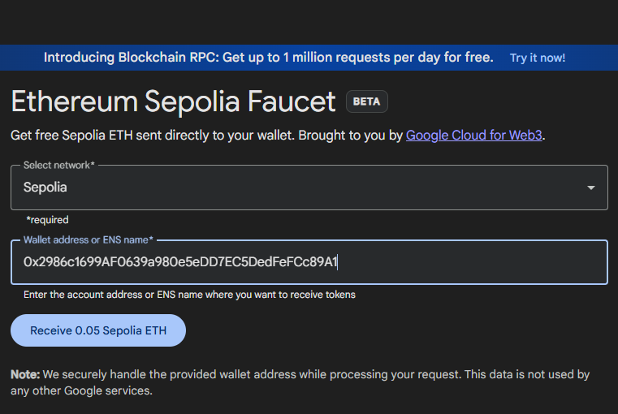
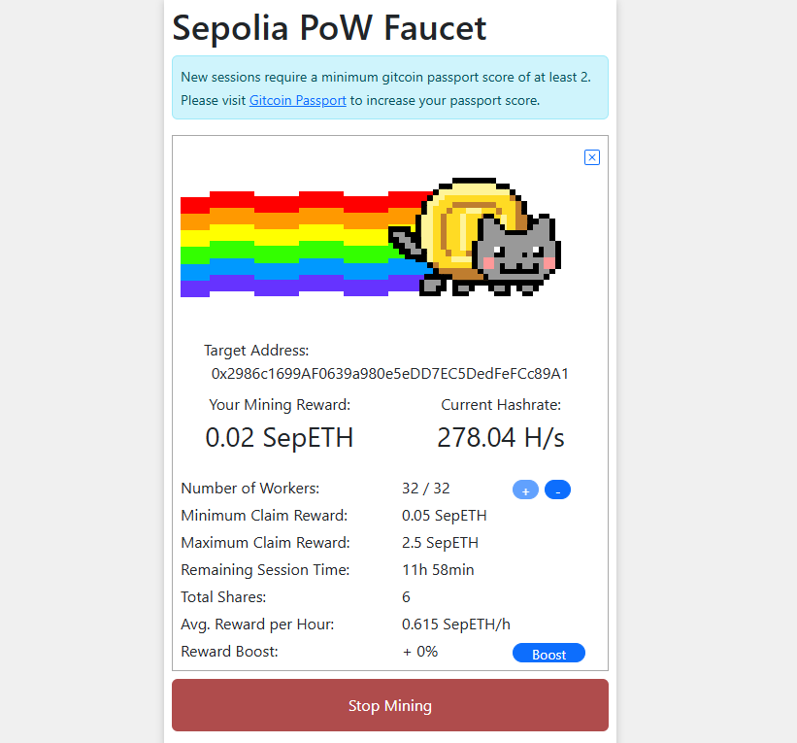
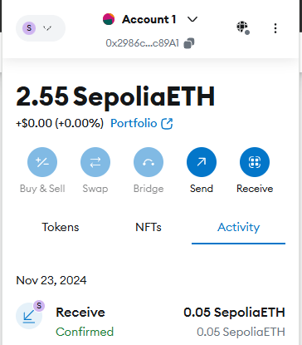
SHIRAJUS SALEKIN NABIL - 19889
ETHEREUM SEPOLIA FAUCET
SEPOLIA POW FAUCET (MINING)
TESTNET ETH ON OUR WALLET
PREREQUISITES
PREREQUISITES
Go to
https://app.passport.xyz/#/ , and then
https://sepolia-faucet.pk910.de/#/
Go to https://cloud.google.com/application/web3/faucet/ethereum/sepolia :
Now, managed to get some testnet ETH, and good to go with the further process.

Slide 8
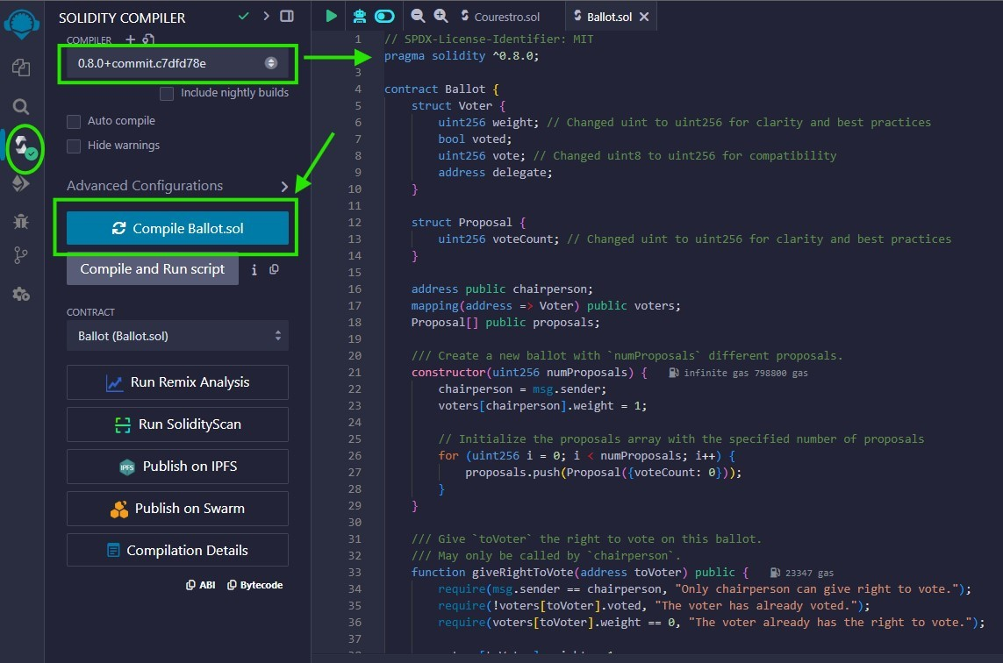
Implementation
SHIRAJUS SALEKIN NABIL - 19889
IMPLEMENTATION
Let’s compile our ballot.sol now in solidity version 0.8.0
Deploy the smart contract on Sepolia Testnet on Injected Provider -MetaMask environment
Create some accounts, since the contract involves multiple users to interact
Name them Alice, Bob, and Charlie for easier Demonstration
Send ETH to each of those newly created wallet
Connect them to Remix IDE
Experiment the use cases

Slide 9
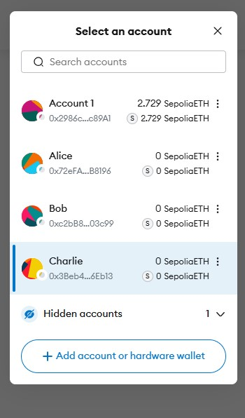
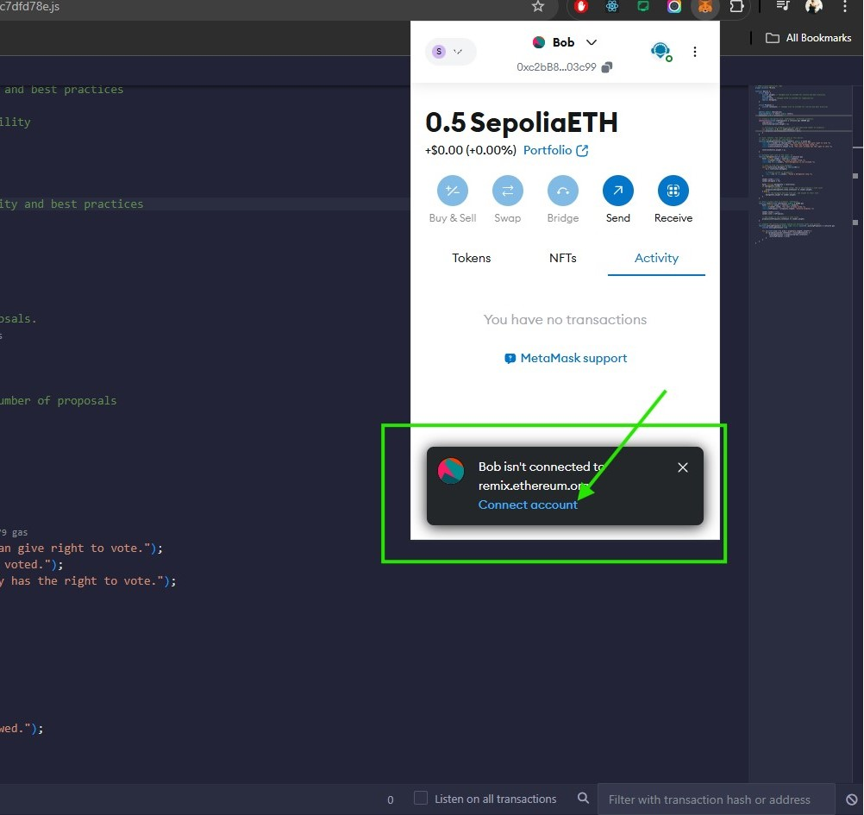
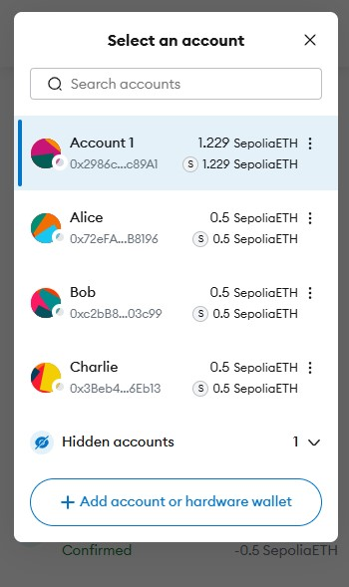
SHIRAJUS SALEKIN NABIL - 19889
ETH SENT TO ALL ACCOUNTS
NEW ACCOUNTS CREATED
CONNECT ACCOUNTS TO REMIX
IMPLEMENTATION
Sent testnet ETH to all of the newly created accounts.
Named them Alice, Bob, and Charlie for easier Demonstration
All the accounts are connected to the Remix IDE

Slide 10
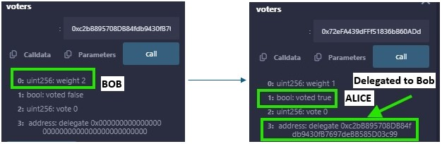
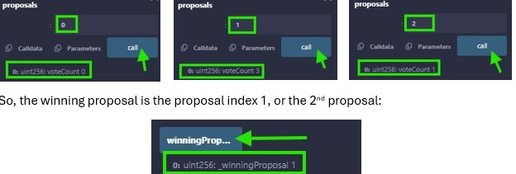
SHIRAJUS SALEKIN NABIL - 19889
DELEGATED ALICE’S VOTE TO BOB
CHECKING THE STATUS AS VOTER
CHECKING THE WINNING PROPOSAL
EXPERIMENTING USE CASES
EXPERIMENTING USE CASES
Switched to Alice’s account and delegated her vote to Bob by pasting Bob’s address on delegate and clicked Transact while Alice’s Wallet is active on MetaMask
Bob’s vote has weight 2 now, and Alice’s vote is considered as given, because she passed it to Bob. Now Bob will vote on behalf of Alice, and himself.
Now, Proposal index 0 has 0 vote, 1 has 3 votes, and 2 has 1 vote.
So, the winning proposal is the proposal index 1, or the 2nd proposal

Slide 11
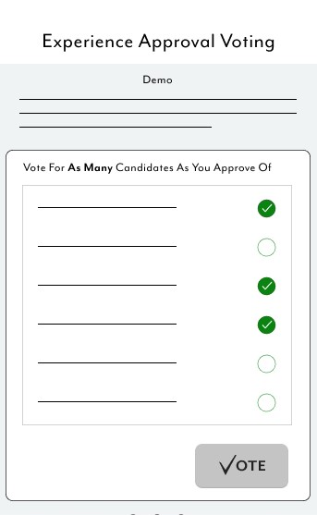
SHIRAJUS SALEKIN NABIL - 19889
HOW TO ENHANCE
ENHANCEMENT IDEAS
An User Interface can be added to enhance User Experience.
Web App,
Mobile App.

Slide 12
SHIRAJUS SALEKIN NABIL - 19889
CONCLUSION
CONCLUSION
This project successfully developed and tested a decentralized voting system on Ethereum’s Sepolia Testnet, addressing transparency and security challenges in traditional voting. A smart contract was implemented to manage voting rights, delegation, and proposal tallying, with proposal 2 emerging as the winner.
Challenges such as account management and transaction debugging were resolved through testing and efficient use of tools like Remix IDE. The project highlights blockchain's potential for transparent governance and points to future improvements, including scalability and identity integration.

Slide 13
CONTACT
SHIRAJUS SALEKIN NABIL - 19889
PRODUCT OVERVIEW
Please feel free to reach out with any
Questions, compliments, or concerns.
Email: snabil61818@student.sfbu.edu
Tel: (628)946-6188
IG: @Salekin_Nabil

Slide 14
REFERENCES
SHIRAJUS SALEKIN NABIL - 19889
REFERENCES
R1
R2
R3
R4
https://cloud.google.com/application/web3/faucet/ethereum/sepolia
https://app.passport.xyz/#/
https://github.com/Salekin-Nabil/Blockchain-Based-Ballot/tree/main
https://sepolia-faucet.pk910.de/#/

Slide 15

THANK YOU
Let’s Prepare For The Decentralised Future.

